Slide 1

Sage 300 Web SDK 2023.0 Overview
John Thomas (JT)
Principal Software Architect
August 2022

Slide 2
Web SDK
SDK
Wizards
Docs
Resources
Samples
Source
Goal
“The goal of the Web SDK is to get developers up and running quickly and easily.”

Slide 3

Corrected Issues

Slide 4
Corrected Issues
Fixed crash of code generation wizard if model property is dropped on border of palette Resolved issue in CSS with checkboxes not displaying in Tree View Enhanced “and” “or” logic for Security Resources in the menu XML files Adding ObjSafe.tlb to the Sage runtime folder allows VB OCX’s to be added to managed forms Implemented proper destroy logic for popup windows in the event there are multiple popups Corrected View Attributes in Accpac Layer that was not being updated properly
Updated Payment Codes and Clear Statistics samples with current implementation standards
N/A
Misc
Samples
Custom

Slide 5

Wizards

Slide 6
Wizards
Standalone Rebranded Sage image Rollover to 70A
Plug-in Sync global files Rebranded Sage image
Sync resource files Rebranded Sage image Rollover to 70A
New wizard Adds ViewField Attribute to public model properties
Solution
Sync global files Rebranded Sage image Rollover to 70A
Sync global files Rebranded Sage image Rollover to 70A
Sync global files Rebranded Sage image Rollover to 70A
Custom
Code
Language
Upgrade
View Field

Slide 7
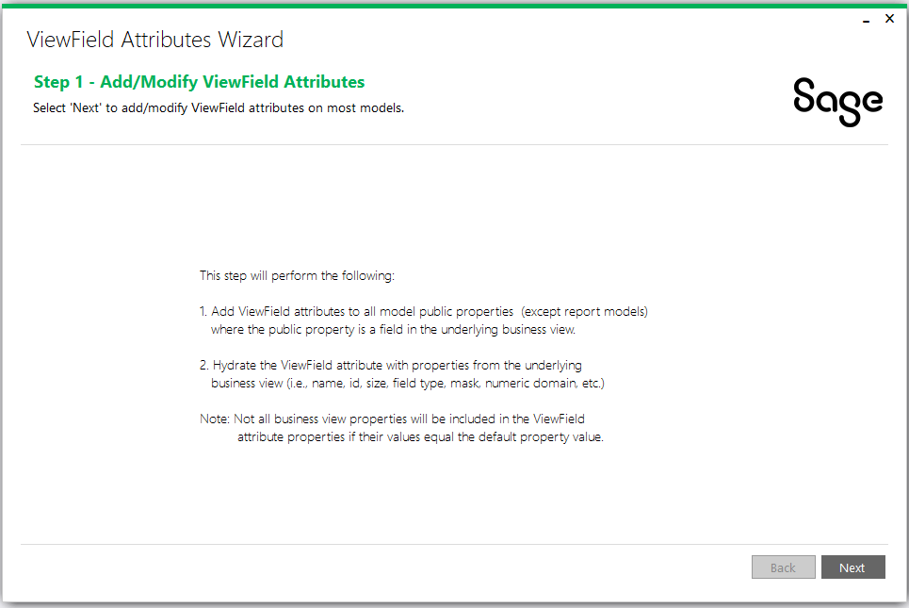
Wizards
View Field Attribute Wizard
Adds ‘ViewField’ attribute to model’s public properties
Hydrates attribute properties from underlying business view’s fields
Used by JavaScript developers to leverage framework helpers for assigned model property values
To be leveraged in the future by new HTML Helpers which will reduce CSHTML code
Only source provided as opposed to binary and source
Partners will need to modify wizard to add reference to partner models
Refer to document in docs/wizards folder
Web Screens

Slide 8

Samples

Slide 9
Samples
Sync global files
Rebranded Sage image
Rollover to 70A
Web Screens

Slide 10
Web API

Slide 11
Web API
Rollover to 70A
Web Screens

Slide 12

Documentation and Tutorials

Slide 13
Documentation and Tutorials
Rollover to 70A
Rebranded Sage image
Update CommonCore.chm
Updated upgrade instructions 2022.2 → 2023.0
Updated Grid Client Interface for new ‘buildFilterString” method
Created Declarative Setup Reports Design document for simple declarative report creation
Created Declarative Setup Reports Interface document for simple declarative report creation
Created View Field Attribute Wizard document for new wizard instructions and usage
Created Standards, Patterns, and Code Review Presentation
Created The Basics (Overview of Web SDK, Web API, Architectures, etc.) presentation
Created Hands On (Labs for Wizards, Web API, and Customization) presentation
Web Screens

Slide 14

Declarative Report Framework for Simple Reports
New framework for simple reports
Only requires JSON config file
Refer to docs in docs/development folder for examples and interfaces

Slide 15
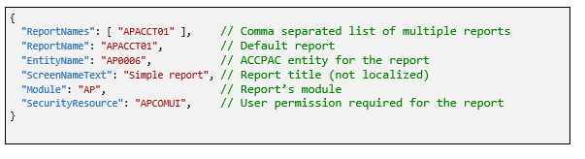
Declarative Framework for Simple Reports
Sample Configuration and Example
Web Screens
Very simple report
No parameters
No user input

Slide 16
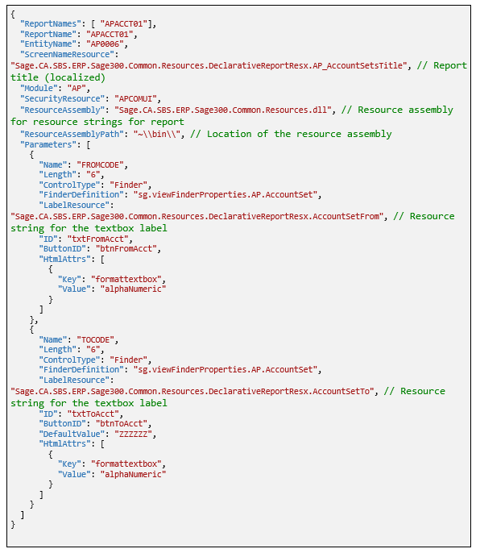
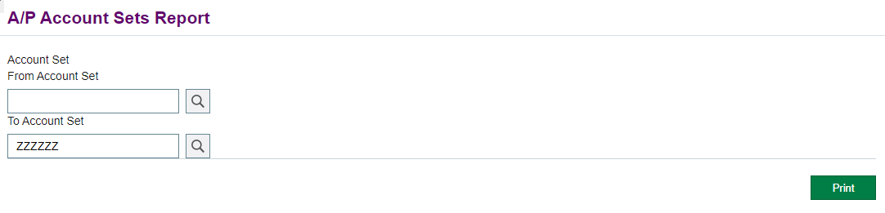
Declarative Framework for Simple Reports
Sample Configuration and Example
Simple report
A couple of parameters
A couple of user inputs
Supports localization
Web Screens

Slide 17
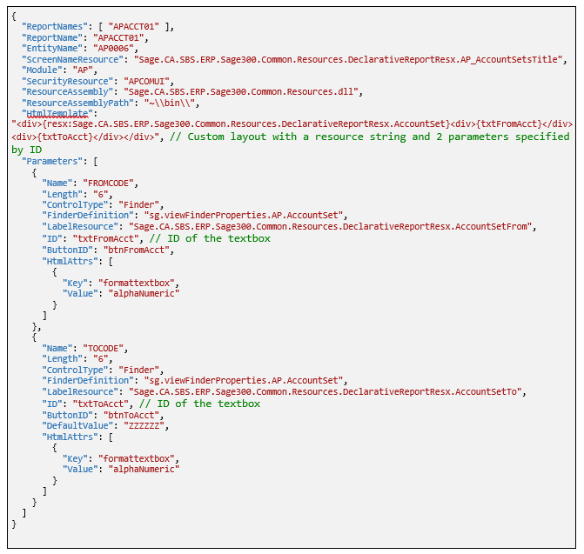
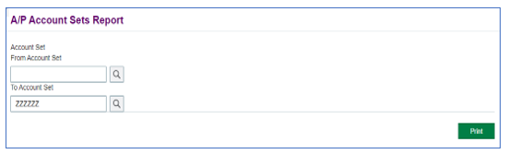
Declarative Framework for Simple Reports
Sample Configuration and Example
Simple report
A couple of parameters
A couple of user inputs
Supports localization
Supports custom layout
Web Screens

Slide 18
GitHub Repository

Slide 19
GitHub Repository
Open Source
https://github.com/SageNADev/Sage300-SDK
2023.0 is available in the “master” branch
2023.1 is available in the “develop” branch
Archives
2022.1 available in “release-2022.2”
2022.1 available in “release-2022.1”
2022.0 available in “release-2022.0”
2021.2 available in “release-2021.2”
2021.0 available in “release-2021.0”
2020.2 available in “release-2020.2”
2020.1 available in “release-2020.1”
2020.0 available in “release-2020.0”
2019.2 available in “release-2019.2”
2019.1 available in “release-2019.1”
2019.0 available in “release-2019.0”
2018.2 available in “release-2018.2”
2018.1 available in “release-2018.1”
2018.0 available in “release-2018”
2017.2 available in “release-2017.2”
2017.1 available in “release-2017.1”
2017.0 available in “release-2017”
Web Screens

Slide 20
Partner Requests

Slide 21
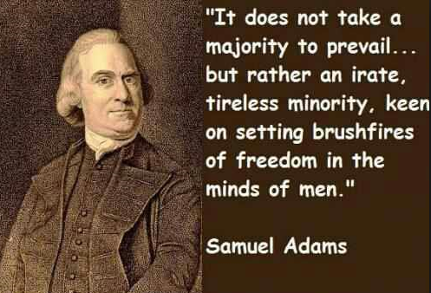
Partner Requests
Bring these to the Sage 300 Product Manager
Add these to the Sage 300 Ideas Site
Sage 300 Ideas Forum
Your voice and feedback resounds the loudest!
Web Screens

Slide 22
Thank you!

